Slide 1
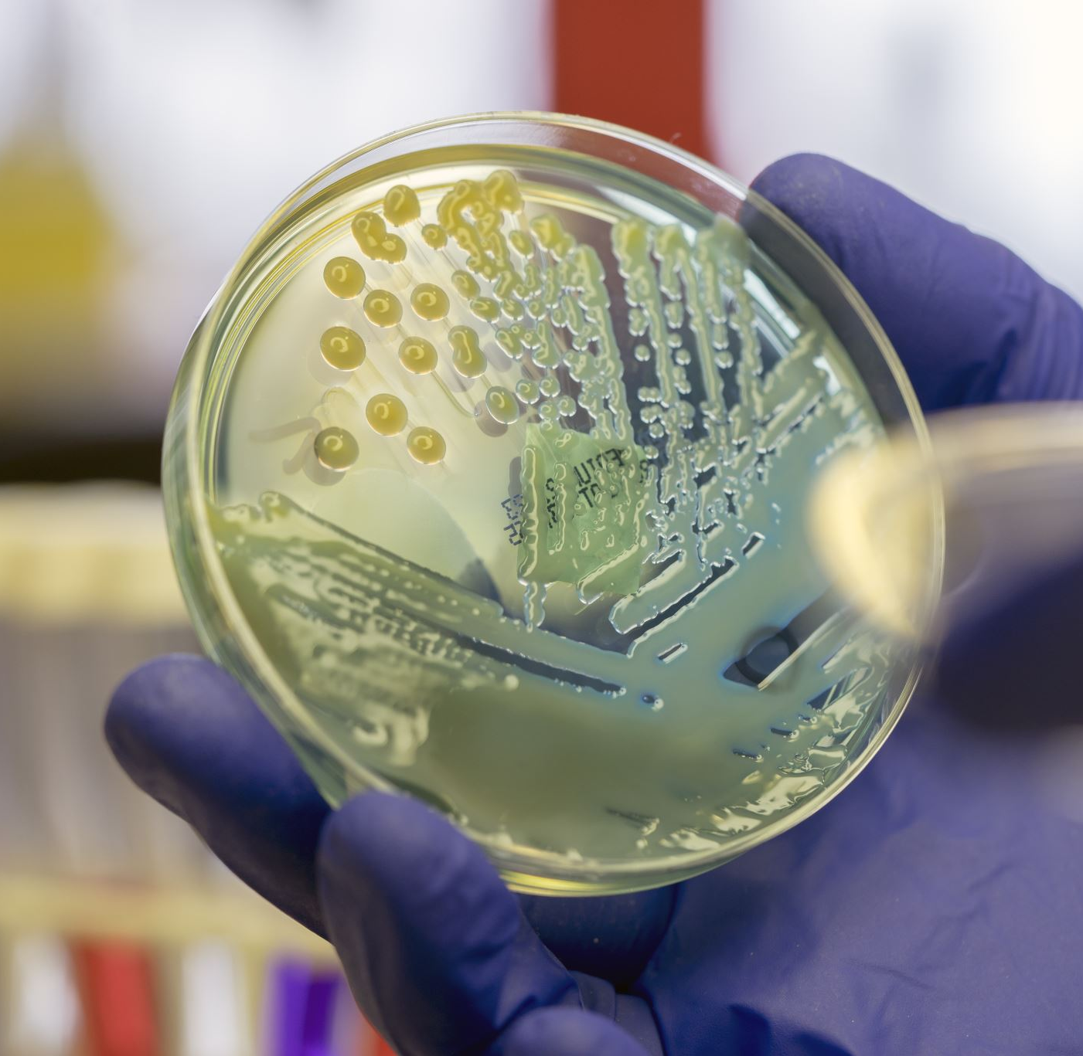
Microbial Nanoparticle Production (Contd.)
Bionanotechnology
BBL747

Slide 2
Bacterial Nanoparticle Production
The development of protocols for the synthesis of semiconductor nanoparticles such as CdS for application as quantum-dot fluorescent biomarkers in cell labeling
Simple variation of the particle size enables tailoring of the band gap(valence and conduction band) and, consequently, the color of the quantum dots during UV-light irradiation
Exposure of the bacterium Klebsiella aerogenes to Cd²⁺ ions resulted in the intracellular formation of CdS nanoparticles in the size range 20–200 nm
The composition of the nanoparticles formed was a strong function of buffered growth medium for the bacterium.

Slide 3
Bacterial Nanoparticle Production
For the growth of magnetic nanoparticles, Roh and co-workers showed that metals such as Co, Cr, and Ni may be substituted into magnetite crystals biosynthesized in the thermophilic iron-reducing bacterium Thermoanaerobacter ethanolicus (TOR-39)
This procedure led to the formation of octahedral shaped magnetite nanoparticles in large quantities that co-existed with a poorly crystalline magnetite phase near the surface of the cells.
A more fundamental investigation into the assembly of single-domain magnetite particles harvested from the bacterium Magnetospirillum magnetotacticum into folded-chain and flux-closure ring morphologies was carried out by Philipse and Maas
The TEM images show the magnetite particles extracted from the bacterial biomass by sonication, are ~ 4.7 nm in diameter and predominantly organized in the form of rings and, more infrequently, as linear superstructures.

Slide 4
Bacterial Nanoparticle Production
The magnetite crystals are single domains with large magnetic moments that, when constrained to lie on a two-dimensional surface, are responsible for the head-to-tail assembly.
The circular structures were explained by the authors to be flux-closure rings of in-plane dipoles.
In conventional ferrofluids, the magnetic moments of the particles are much smaller than that observed for biogenic magnetite and therefore, such linear and ring-like structures have not been observed.
Magnetization measurements of dried magnetite particles harvested from the bacterial cells, established that the biogenic magnetite nanoparticles are not superparamagnetic

Slide 6
Fungal nanoparticles production
Exposure of yeasts such as Candida glabrata and Schizosaccharomyces pombe to Cd²⁺ ions leads to the intracellular formation of CdS quantum dots
In this case, Yeast cells exposed to Cd²⁺ ions produce metal-chelating peptides (glutathiones),and an increase in the intracellular sulfide concentration and the formation of nanocrystalline CdS.
The biogenic CdS quantum dots are capped and stabilized by the peptides, glutathione and its derivative phytochelatins with the general structure (γ-Glu-Cys)_{n}Gly
The yeast, Torulopsis sp. as being capable of intracellular synthesis of nanoscale PbS crystallites when exposed to aqueous Pb²⁺ ions
The PbS nanoparticles were extracted from the biomass by freeze–thawing and analyzed using a variety of techniques.
A blue shift in the absorption edge suggested that the particles were in the quantum size regime.
A HRTEM image of the PbS nanoparticles shows that the particles are spherical, size from 4 to 8 nm, crystalline and exhibit a well-developed electron diffraction pattern with evidence for mixed cubic and hexagonal phases in the particles.

Slide 7
Fungal nanoparticles production
Ultimately, biogenic nanoparticles would have to compete with chemically synthesized nanoparticles in terms of performance in devices.
As a step in this direction, Kowshik et al. have shown that CdS quantum dots synthesized intracellularly in Schizosaccharomyces pombe yeast cells exhibit ideal diode characteristics
Biogenic CdS nanoparticles in the size range 1–1.5 nm were used in the fabrication of a heterojunction with poly(p-phenylenevinylene).
Such a diode exhibited 75 mA cm^{–2} current in the forward bias mode at 10 V, while breakdown occurred at 15 V in the reverse direction.
The use of fungi in the synthesis of nanoparticles is a relatively recent addition to the list of microbes discussed above.
A detailed screening process involving approximately 200 genera of fungi resulted in two genera which, when challenged with aqueous metal ions such as AuCl^{4–} and Ag²⁺, yielded large quantities of metal nanoparticles either extracellularly (Fusarium oxysporum) or intracellularly (Verticillium sp.)

Slide 9
Fungal nanoparticles production
Flasks containing the Verticillium sp. biomass after exposure to 10^{–4} M HAuCl₄ solution for 72 hours have a distinctive purple color indicating formation of gold nanoparticles and can be seen in UV-visible absorption spectrum as a resonance at ~ 540 nm
This resonance is clearly missing in the biomass before exposure to gold ions and in the filtrate after reaction of Verticillium with the gold ions.
The gold ions are thus reduced intracellularly, further evidence of which is provided by TEM analysis of thin sections of the cells after formation of gold nanoparticles
At low-magnification TEM image, spherical gold nanoparticles are seen close to surface of the cells. At higher magnification, the nanoparticles ranging in size from 5 nm to 200 nm with an average size of 20+8 nm are seen populating both the cell wall and cytoplasmic membrane of the fungus.
From the powder X-ray diffraction pattern recorded from the biofilm, the gold nanoparticles are found crystalline, and are characteristic of face-centered cubic (fcc) gold structure.
The reduction of the gold ions is expected to be due to reaction with enzymes present in the cell walls of the mycelia

Slide 10
Figure 9.5 (A) UV/Visible spectra recorded from biofilms of the Verticillium sp. fungal cells before (curve 1) and after (curve 2) exposure to 10^{–4} M aqueous HAuCl₄ solution for 72 hours. The spectrum recorded from the HAuCl₄ solution after immersion of the fungal cells for 72 hours is shown for comparison (dashed line). (B) X-ray diffraction pattern recorded from an Au nano-Verticillium biofilm formed on a Si (111) wafer. The principal Bragg reflections are identified. The inset shows pictures of the Verticillium fungal cells after removal from the culture medium (flask on top) and after exposure to 10^{–4} M aqueous solution of HAuCl₄ for 72 hours (flask at bottom). (C, D) TEM images at different magnifications of thin sections of stained Verticillium cells after reaction with AuCl₄– ions for 72 hours.

Slide 11
Fungal nanoparticles production
Exposure of Verticillium sp. to silver ions resulted in a similar intracellular growth of silver nanoparticles
From the application point of view, extracellular synthesis of nanoparticles would be more important.
It was observed that exposure of the fungus Fusarium oxysporum to aqueous gold and silver ions leads to the formation of fairly monodisperse nanoparticles in solution
Even more exciting was the finding that exposure of Fusarium oxysporum to aqueous CdSO₄ solution yielded CdS quantum dots extracellularly
CdS nanoparticles formed after reaction of 10^{–4} M CdSO₄ solution with the Fusarium oxysporum biomass for 12 days.
The particles are reasonably monodisperse, and range in size from 5 to 20 nm.
X-ray diffraction analysis of a film of the particles formed on a Si (111) wafer clearly showed that the particles were nanocrystalline with Bragg reflections characteristic of hexagonal CdS

Slide 12
Fungal nanoparticles production
Reaction of the fungal biomass with aqueous CdNO₃ solution for an extended period did not yield CdS nanoparticles, indicating the possibility of release of a sulfate reductase enzyme into solution.
Polyacrylamide gel electrophoresis (PAGE) results of the aqueous extract exposed to the fungal biomass for 12 days, indicate the presence of at least four protein bands in the extract.
Reaction of the protein extract after dialysis (using a dialysis bag with 3kDa molecular weight cutoff) with CdSO₄ solution did not yield CdS nanoparticles.
However, addition of ATP and NADH to the dialysate restored the CdS formation capability of the protein extract.
It is believed that the same proteins are also responsible for the reduction of gold and silver ions
The gold, silver, and CdS nanoparticles were stable in solution for many months due to stabilization by surface-bound proteins

Slide 14
Fungal nanoparticles production
The development of a rational nanoparticle biosynthesis procedure using specific enzymes secreted by fungi in both the intra- and extracellular synthesis of nanoparticles has many attractive associated features.
Plant pathogenic fungi produce copious quantities of enzymes, are usually nonpathogenic to humans, and are easily cultured in the laboratory.

Slide 15
Outlook
A case for the serious investigation of microorganisms such as bacteria, algae, yeasts, actinomycetes, and fungi as possible inorganic nanofactories has been made.
A number of issues from the nanotechnology and microbiology points of view require to be addressed before such a biosynthesis procedure can compete with existing physical and chemical synthesis protocols.
The elucidation of biochemical pathways leading to metal ion reduction or formation of insoluble complexes in the different classes of microbes is essential in order to develop a rational microbial nanoparticle synthesis procedure.
An understanding of the surface chemistry of the biogenic nanoparticles (i. e., the nature of capping surfactants/peptides/proteins) would be equally important.
This would then lead to the possibility of genetically engineering microbes to overexpress specific reducing molecules and capping agents, thereby controlling not only the size of the nanoparticles but also their shape.

Slide 16
Outlook
The rational use of constrained environments within cells such as the periplasmic space and cytoplasmic vesicular compartments (e. g., magnetosomes) to modulate nanoparticle size and shape is an exciting possibility.
The range of chemical compositions of nanoparticles currently accessible by microbial methods is currently extremely limited and confined to metals, some metal sulfides and iron oxide.
Extension of the protocols to enable reliable synthesis of nanocrystals of other oxides (TiO₂, ZrO₂, etc.) and nitrides, carbides, etc. could make microbial synthesis a commercially viable proposition.
Equally intriguing are questions related to the metal ion reduction/reaction process in cellular metabolism, and whether the nanoparticles formed as byproducts of the reduction process have any role to play in cellular activity (e. g., magnetite in magnetotactic bacteria).
Plant organisms (e. g., fungi) are not normally exposed to high concentrations of metal ions such as Cd²⁺ , AuCl₄– and Ag²⁺ , but, when challenged, they secrete enzymes that are capable of metal ion reduction and indeed conversion of sulfates to sulfides suggests that evolutionary processes may be at play.

